Slide 1
Lesson 18 – Spring Security

Slide 2

Contents
Authentication vs Authorization
InMemory Authentication
Authentication Provider
Remember Me

Slide 3
Spring Security
Java framework that provides:
Authentication
Authorization
Started in 2003 as 'Acegi Security‘. The first public release as Spring Security 2.0.0 - April 2008.

Slide 4
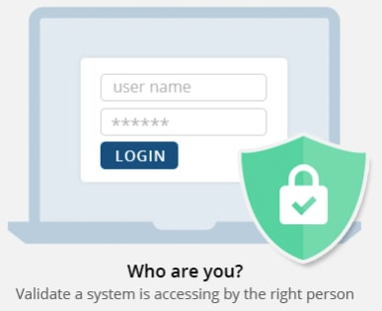
Authentication

Slide 5
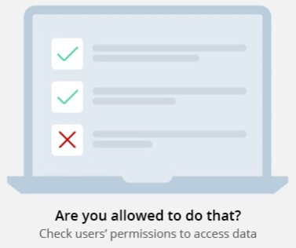
Authorization

Slide 6
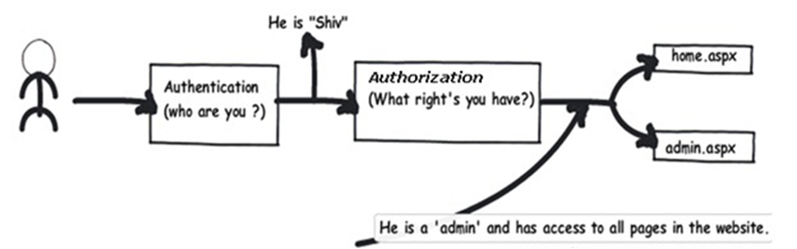
Login = AuthN + AuthZ

Slide 7
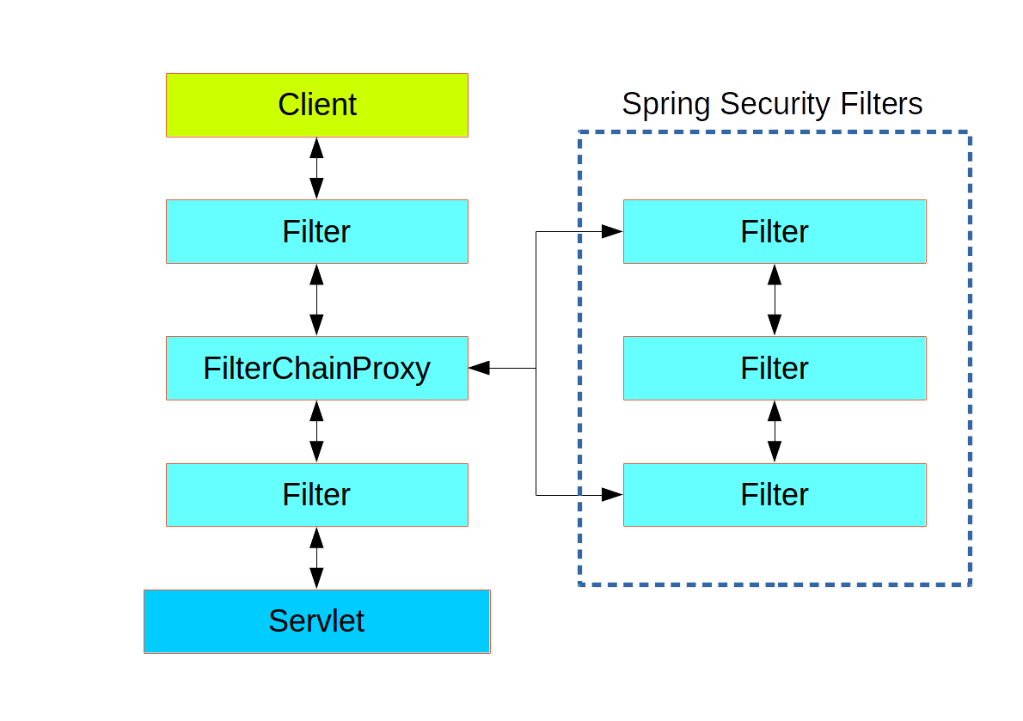
Login = AuthN + AuthZ

Slide 8
Supported auth technologies
Login and Password
Oauth
SAML
OpenID
Custom tokens
…

Slide 9
Authentication

Slide 10
Authentication
Principal – user identity
user id
user email
…
Credentials – credibility of user identity
password
token
…

Slide 11
Setup
implementation 'org.springframework.boot:spring-boot-starter-security'
testImplementation 'org.springframework.security:spring-security-test'
@SpringBootApplication @EnableWebSecurity public class GeekHubCrypto { public static void main(String[] args) { SpringApplication.run(GeekHubCrypto.class, args); } }

Slide 12
InMemory Authentication
@Configuration class InMemorySecurityConfig extends WebSecurityConfigurerAdapter { @Autowired public void configureGlobal(AuthenticationManagerBuilder auth) { auth.inMemoryAuthentication()
.withUser("user")
.password("user")
.roles(“ROLE_USER");
auth.inMemoryAuthentication()
.withUser("admin")
.password("admin")
.roles("ROLE_ADMIN"); } }
@Configuration @EnableWebSecurity public class InMemorySecurityConfig extends WebSecurityConfigurerAdapter { }

Slide 13
External authentication provider
Fetch user information from a specific repository by:
User email and password
Token one
Another token
…

Slide 14
Authentication provider
public interface AuthenticationProvider { Authentication authenticate(
Authentication authentication
) throws AuthenticationException;
boolean supports(Class<? extends Authentication> type); }

Slide 15
Custom Authentication Provider
@Component public class LoginPasswordAuthenticationProvider implements AuthenticationProvider { @Override public Authentication authenticate(Authentication authentication) throws AuthenticationException { String username = authentication.getName(); String password = authentication.getCredentials().toString();
Optional<User> user = userService.findBy(username);
if (user.isPresent() && passwordEncoder.matches(password, user.get().getPassword())) { return new UsernamePasswordAuthenticationToken(user, null, emptyList()); } else { return null; } } @Override public boolean supports(Class<?> authentication) { return authentication.equals(UsernamePasswordAuthenticationToken.class); } }

Slide 16
Custom Authentication Provider
@Configuration class WebSecurityConfig extends WebSecurityConfigurerAdapter { @Autowired public void configureGlobal(
LoginPasswordAuthenticationProvider loginPasswordAuthProvider,
AuthenticationManagerBuilder authManagerBuider
) { authManagerBuider.authenticationProvider(loginPasswordAuthProvider); } }

Slide 17

Login page
@Configuration
public class WebSecurityConfig extends WebSecurityConfigurerAdapter { @Override protected void configure(HttpSecurity http) throws Exception { http.formLogin() .loginPage("/login") .loginProcessingUrl("/web-api/login") .usernameParameter("username") .passwordParameter("password")
.permitAll() .and().logout() .logoutUrl("/logout") .logoutSuccessUrl("/login") .permitAll()
}
}

Slide 18
Detecting current user
import org.springframework.security.core.Authentication; import org.springframework.security.core.userdetails.User;
@RestController public class HelloController {
@GetMapping("/hello") public String hello() { Authentication authentication = SecurityContextHolder.getContext()
.getAuthentication(); User principal = (User) authentication.getPrincipal(); return "Hello " + principal.getUsername(); }
}

Slide 19
Detecting current user
import org.springframework.security.core.Authentication; import org.springframework.security.core.userdetails.User;
@RestController public class HelloController {
@GetMapping("/hello") public String hello(@AuthenticationPrincipal User user) { return "Hello " + user.getUsername(); }
}

Slide 20
Authorization

Slide 21
Role
Role - application-wide permissions
GUEST
USER
ADMIN
SUPER_ADMIN
…

Slide 22
Roles specification
@Component public class LoginPasswordAuthenticationProvider implements AuthenticationProvider { @Override public Authentication authenticate(Authentication auth) throws AuthenticationException { … List<GrantedAuthority> authorities = collectAuthorities(user.get()); return new UsernamePasswordAuthenticationToken(user, password, authorities); } private List<GrantedAuthority> collectAuthorities(User user) { List<GrantedAuthority> authorities = new ArrayList<>();
authorities.add(new SimpleGrantedAuthority("USER"));
if (user.isAdmin()) { authorities.add(new SimpleGrantedAuthority("ADMIN")); } return authorities; } }

Slide 23
Role hierarchy
@Bean public RoleHierarchy roleHierarchy() { RoleHierarchyImpl roleHierarchy = new RoleHierarchyImpl();
roleHierarchy.setHierarchy("ROLE_ADMIN > ROLE_USER > ROLE_GUEST"); return roleHierarchy; }

Slide 24
Web Security
@Configuration public class WebSecurityConfig extends WebSecurityConfigurerAdapter { @Override protected void configure(HttpSecurity http) throws Exception { http.authorizeRequests() .antMatchers("/login").permitAll() .antMatchers("/admin/**").hasAuthority("ROLE_ADMIN")
.antMatchers("/analytics/**").hasAuthority("ROLE_ADMIN") .antMatchers("/**").hasAuthority("ROLE_USER"); } }

Slide 25
Method Security
@SpringBootApplication @EnableGlobalMethodSecurity(securedEnabled = true) public class GeekHubCryptoConsoleApplication { public static void main(String[] args) { SpringApplication.run(GeekHubCryptoConsoleApplication.class, args); } }
@Service public class ConsoleMenu { @Secured("ROLE_ADMIN") public void clearHistory() { // Cleaning logic } }

Slide 26
Remember Me
@Configuration public class WebSecurityConfig extends WebSecurityConfigurerAdapter { @Override protected void configure(HttpSecurity http) throws Exception { http.rememberMe() .useSecureCookie(true) .rememberMeCookieName("RememberMe") .key("RememberMeToken")
.tokenRepository(jdbcTokenRepository()) .tokenValiditySeconds(86400)
} }

Slide 27
Homework
Implement user registration. Use in-memory database (H2) for storing 3 users with different privileges:
admin (encode/decode + history view/clean + analytics)
user (encode/decode + history view)
guest (encode/decode)
Use Spring Security for:
Authentication (hash passwords by using BCryptPasswordEncoder)
Access rights check for admin endpoints (history clean, analytics)
Remember-me integration

Slide 28
Useful links
Spring Boot Security
Spring Security FAQ
Remember Me via Spring Security (Baeldung)
Securing a Web Application (Reference doc)

Slide 29
Thanks!
Any Questions?
Or find us in Slack:
@Yaroslav Brahinets
@Vasya Rudas
@Oleksandr Kucher

